Slide 1
Agile and Lean Software Development

Slide 2
As a contrast, what are consumer internet companies doing?
Continuous Integration -> Continuous Delivery -> Continuous Deployment
On „good days‟, Flickr releases a new version every half an
hour (Jun 20, 2005)
IMVU pushes a revision of code to the website every nine minutes (Feb 10, 2009)
The other day we passed product release number 25,000 for WordPress. That means we‟ve averaged about 16 product releases a day, every day for the last four and a half years! (May 19, 2010)
A new version of Google Chrome now due every six weeks
(Jul 22, 2010)
Facebook does code push twice a day (Aug 4, 2012)

Slide 3
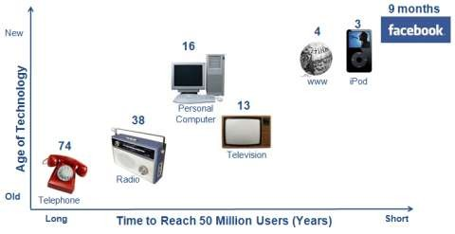
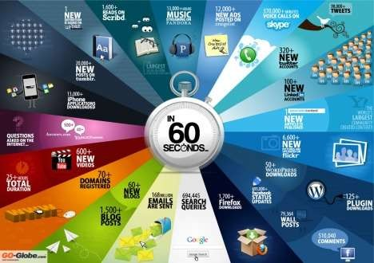
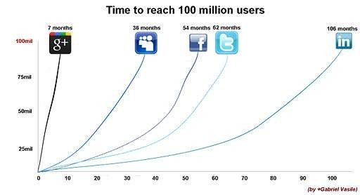
adoption @ net speed!!!
https://lh4.googleusercontent.com/-SQ1ugOgu8Ds/TimaHjH0VpI/AAAAAAAAApU/za0BhEjhoio/w402/google%2Bplus%2Bgrowth%2B20mil.png
http://thesamerowdycrowd.wordpress.com/2011/12/26/a-moment-of-our-time/

Slide 4

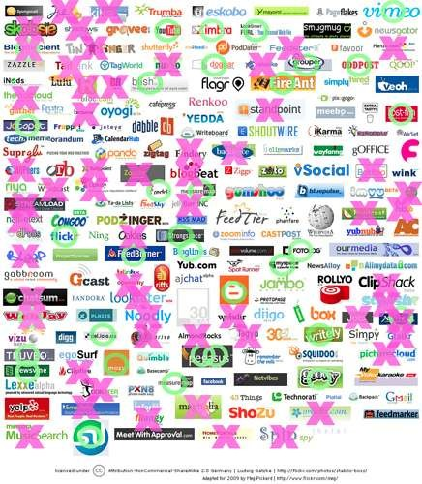

darwin at work on internet
2006
2009
http://www.flickr.com/photos/stabilo-boss/93136022/sizes/o/in/photostream/
http://rossdawsonblog.com/weblog/archives/2009/05/rapid_turnover.html

Slide 5
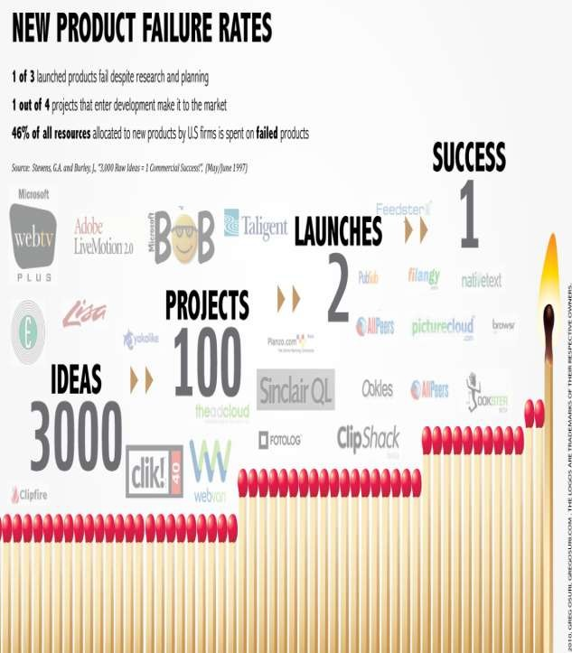
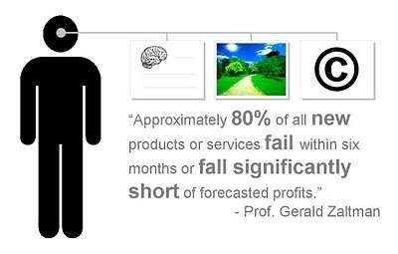
yet, our product development sucks!
http://blog.amplifiedanalytics.com/2011/07/musing-on-difference-between-successful-product-innovation/
http://www.nickblack.org/2009/10/how-brand-trust-affects-new-products.html

Slide 6
Let’s understand the ‘craft’ first…
Sheer joy of making things
Pleasure of things that are useful to other people
Fascination of fashioning complex puzzle-like objects of interlocking moving parts and watching them work in subtle cycles
Joys of always learning, which sprints from the non- repeating nature of the task
Delight of working in such a tractable medium
The Mythical Man Month – Fred Brooks, 1975

Slide 7
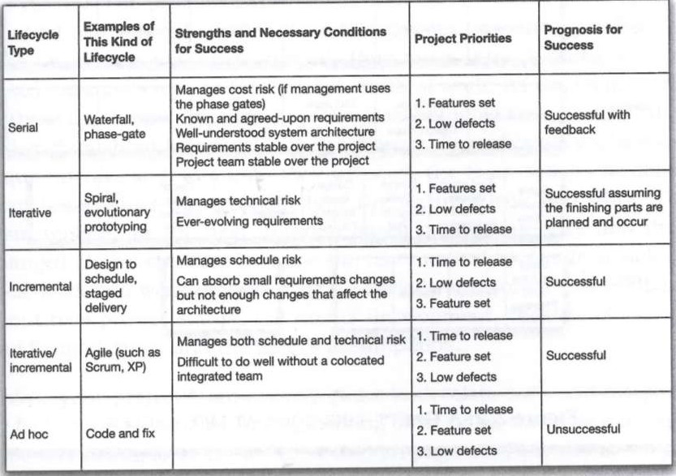
risk management in SDLCs

Slide 8
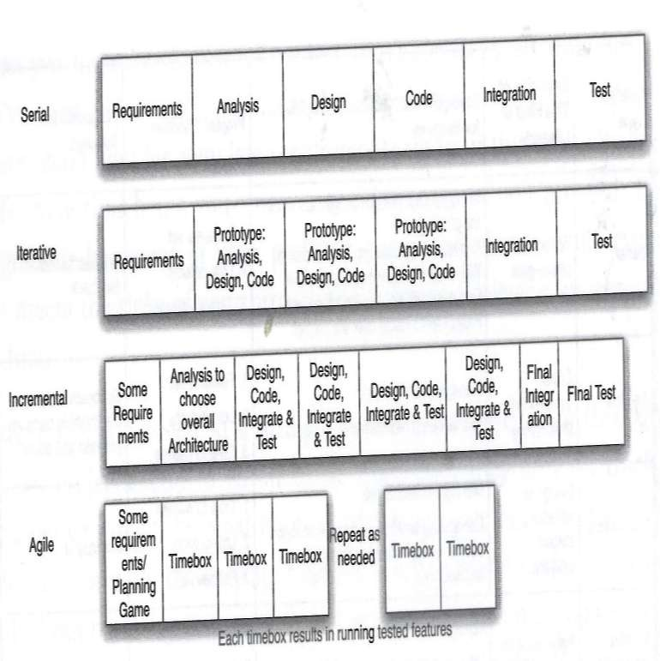
notion of ‘progress’ vs. time

Slide 9
Preamble to Agile Movement
Software Crisis, 1965-85: The major cause of the software crisis is that the machines have become several orders of magnitude more powerful! To put it quite bluntly: as long as there were no
machines, programming was no problem at all; when we had a few weak computers, programming became a mild problem, and now we have gigantic computers, programming has become an equally gigantic problem. — Edsger Dijkstra, The Humble Programmer

Slide 10
Software Crisis
The causes of the software crisis were linked to the overall complexity of hardware and the software development process. The crisis manifested itself in several ways:
Projects running over-budget.
Projects running over-time.
Software was very inefficient.
Software was of low quality.
Software often did not meet requirements.
Projects were unmanageable and code difficult to maintain.
Software was never delivered.

Slide 11


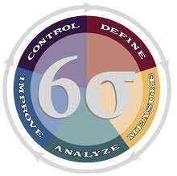







and the response?
Frameworks, Standards and Certifications

Slide 12
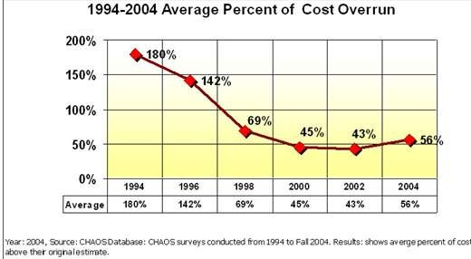
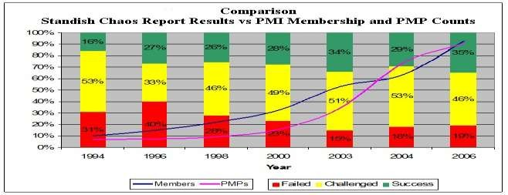
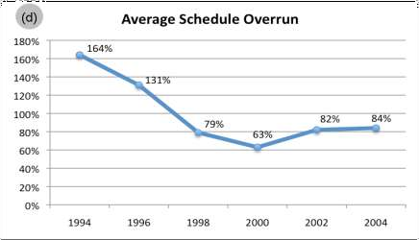
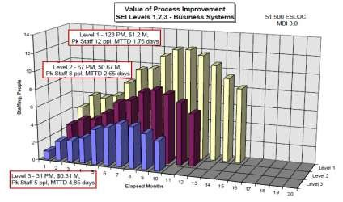
…and the result?…good start…

Slide 13
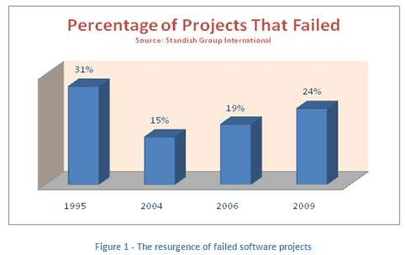
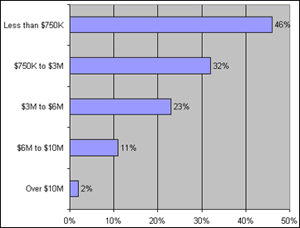
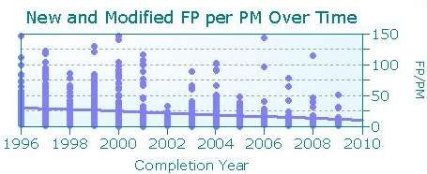
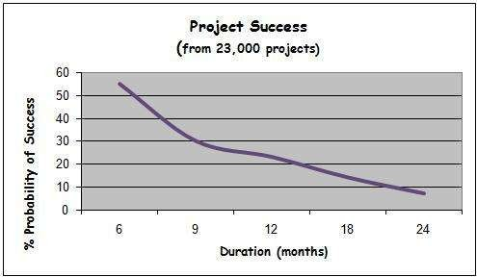
…but poor finish!

Slide 14
Why?
The World had changed! Software increasingly became more business-critical, and delays, cost overruns and poor quality were significantly less acceptable then before!
Process: Long-lead development process ineffective in a dynamic and global world
Management: Command and control model unsuitable for fostering collaboration required to solve complex problems
Technology: Advancements in computers, compiler technology and debugging and testing tools greatly improved the economics of software development

Slide 15
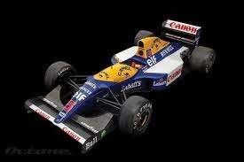

What is the most important part in these two machines?
“The Brakes!!!” They let you go faster…

Slide 16
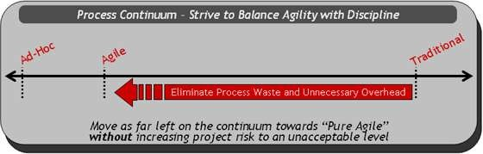
Agility vs. Discipline?
http://www.ibm.com/developerworks/rational/library/edge/08/feb08/lines_barnes_holmes_ambler/

Slide 17
Advent of Agile and Lean Methodologies
1970: Royce critiques Waterfall and offers improvement ideas
1986: Barry Boehm proposes Spiral Model
1971: Harlan Mills proposes Incremental Development
1987: Cleanroom Software engineering
1991: Sashimi Overlapping Waterfall Model
1992: Crystal family of methodologies
1994: DSDM
1995: Scrum
1996: Rational Unified Process framework
1997: Feature Driven Development
1999: Extreme Programming Explained
2001: Agile Manifesto is born
2003: Lean Software Development
2005: PM Declaration of Interdependence
2007: Kanban-based software engineering
2008: Lean Startup
2009: Scrumban
20xx: Something new !?! (hopefully!)

Slide 18
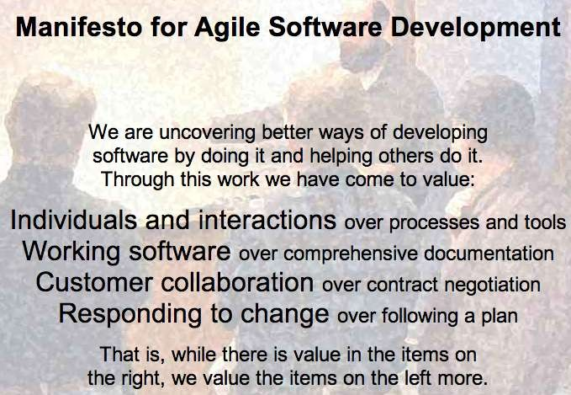

Slide 19












What is agile really all about?
Empowered individuals
Collaboration
Democratic decision-making and transparency
Motivated Individuals
Self- organizing x- functional Teams
Shorter feedback cycle
Manage changing priorities
Increased productivity
Agile Businesses
Higher ROI
Faster time to market
Better User Experience

Slide 20



Why is it so hard?
52%
Organizational Culture
39%
Resistance to Change
34%
Management Support

Slide 21
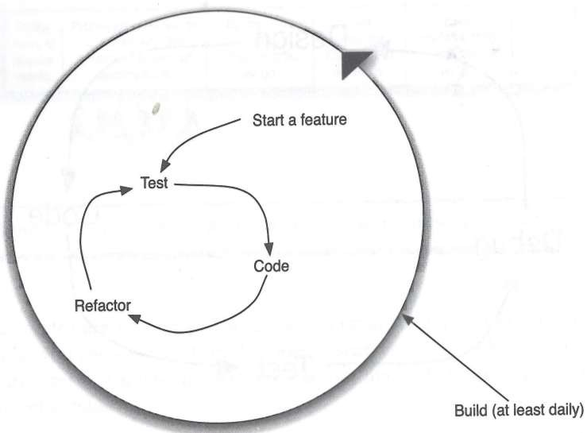
test-code-refactor loop

Slide 22
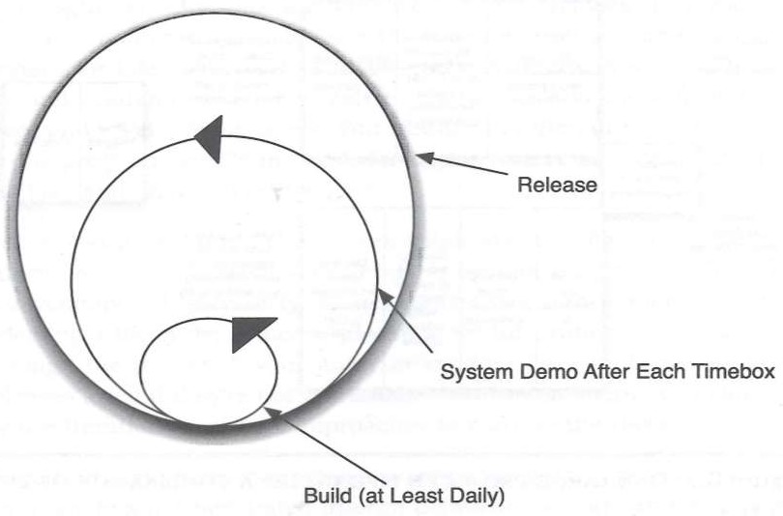
feedback loop in agile lifecycles

Slide 23
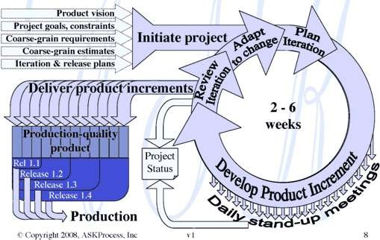
agile lifecycle – big picture

Slide 24
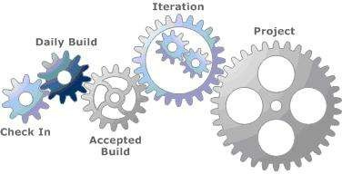
from daily builds to project

Slide 25
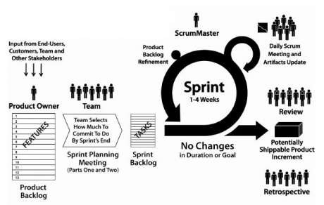
Scrum

Slide 26
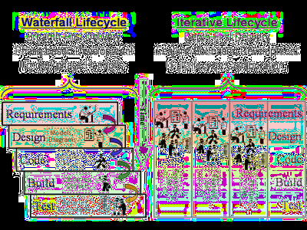
What’s happening here?
http://ayagebeely.blogspot.in/2008_08_01_archive.html

Slide 27
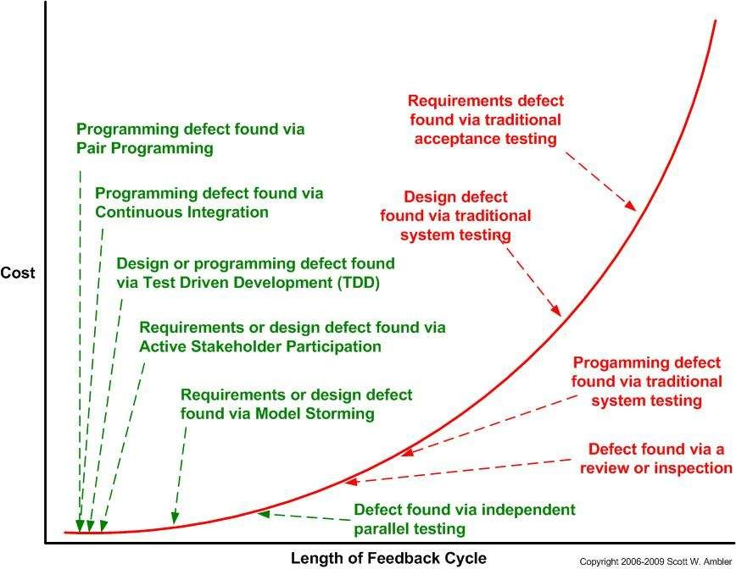
Feedback Loops in Traditional Techniques vs. Agile Techniques

Slide 28
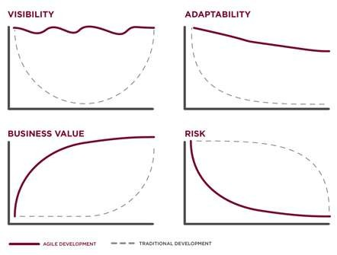
Agile Development Value Proposition
http://www.versionone.com/Agile101/Agile_Benefits.asp

Slide 29
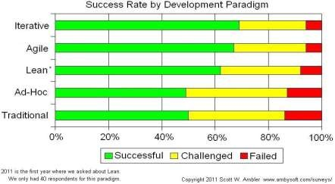
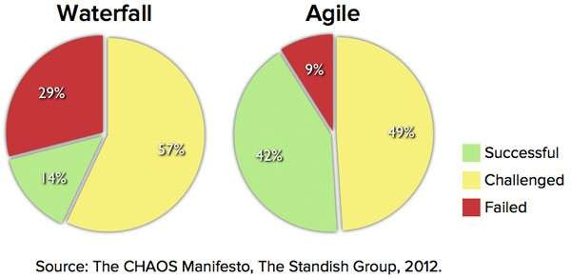
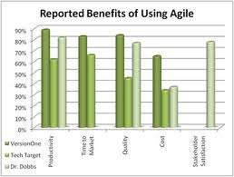
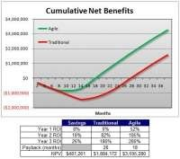
Does Agile work?
http://www.bigvisible.com/2009/12/taking-agile-beyond-faster/
http://www.testingthefuture.net/page/2/

Slide 30
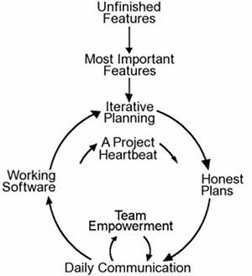
XP - eXtreme Programming
improve software quality and responsiveness to changing customer requirements
frequent releases in short
development cycles
improve productivity and regular checkpoints with the customer
paired programming
www.torak.com

Slide 31
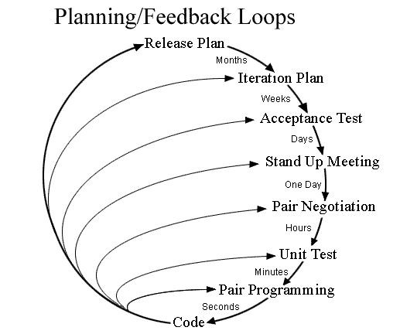
XP - eXtreme Programming
www.torak.com

Slide 32
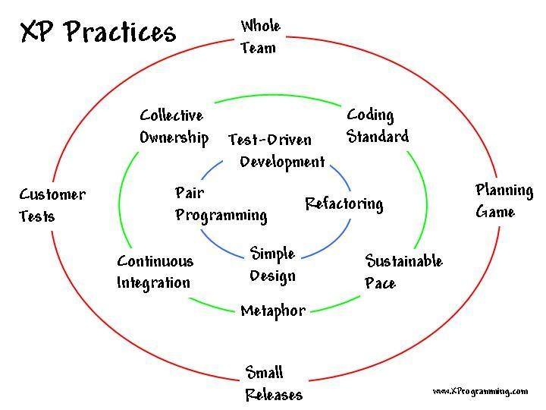
www.torak.com

Slide 33
What is Lean?
The core idea is to maximize customer value while minimizing waste. Simply, lean
means creating more value for customers with
fewer resources.
A lean organization understands customer value and focuses its key processes to continuously increase it. The ultimate goal is to provide perfect value to the customer through a perfect value creation process that has zero waste.

Slide 34
Lean Thinking
Lean thinking changes the focus of management from optimizing separate technologies, assets, and vertical departments to optimizing the flow of products and services through entire value streams that flow horizontally across technologies, assets, and departments to customers.
Eliminating waste along entire value streams, instead of at isolated points, creates processes that need less human effort, less space, less capital, and less time to make products and services at far less costs and with much fewer
defects, compared with traditional business systems.
Companies are able to respond to changing customer desires with high variety, high quality, low cost, and with very fast throughput times. Also, information management becomes much simpler and more accurate.

Slide 35
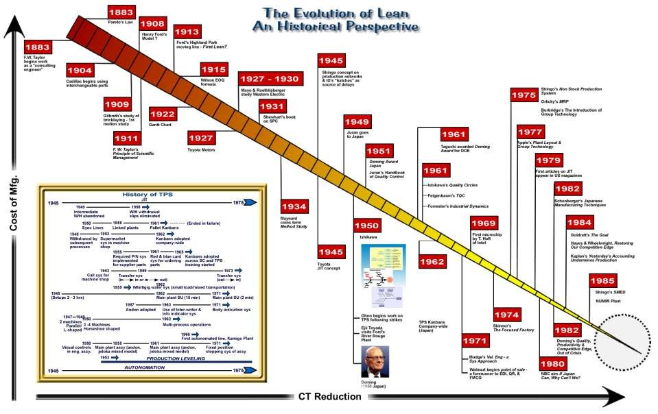
http://www.shmula.com/lean-history-and-timeline-toyota-production-system/5993/

Slide 36










Lean Principles
1. Identify Value
2. Map the Value Stream
5. Seek
Perfection
4.
Establish Pull
3. Create Flow

Slide 37
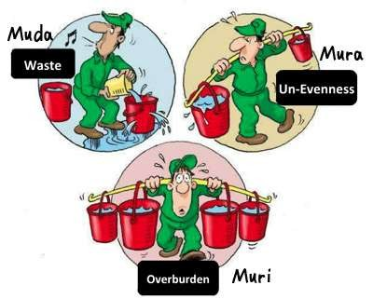
Wastes in Lean
http://nantachit.exteen.com/20120131/muda-muri-mura

Slide 38
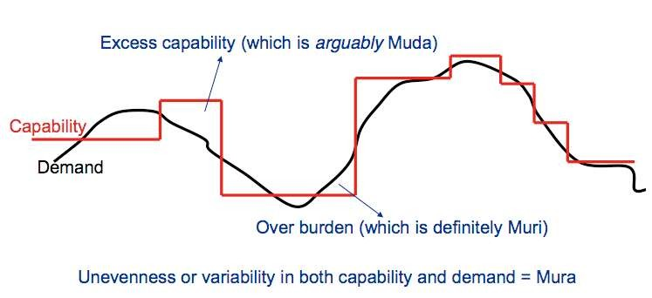
How they manifest?
https://leanandkanban.wordpress.com/2011/03/22/lean-is-about-eliminating-waste-right/

Slide 39
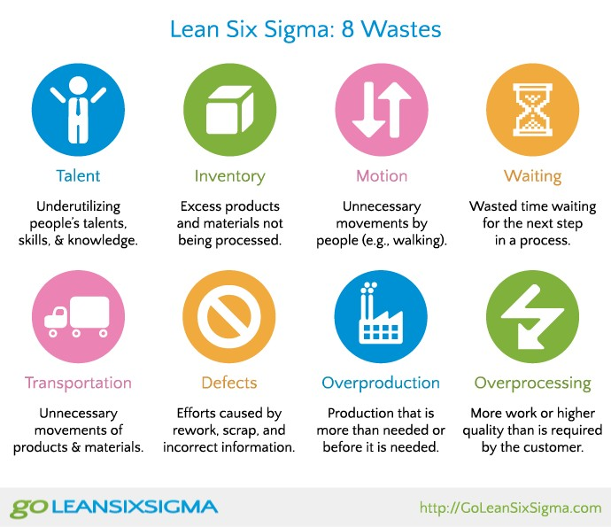

Slide 40
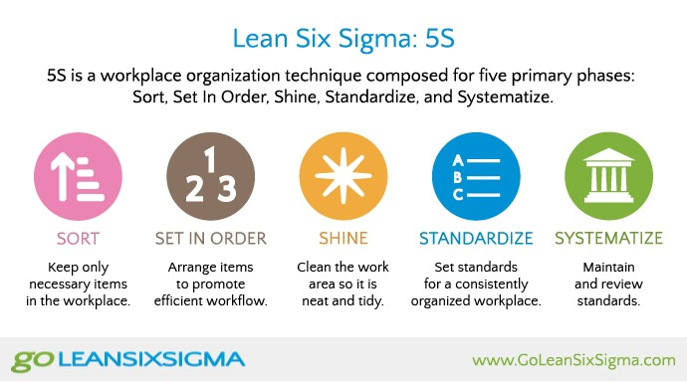

Slide 41
Lean Software Development
Optimize the Whole
Eliminate Waste
Build Quality In
Learn Constantly
Deliver Fast
Engage Everyone
Keep Getting Better
www.poppendieck.com

Slide 42
Optimize the Whole
Optimizing a part of a system will always, over time, sub-optimize the overall system.
Focus on the Entire Value Stream
From concept to cash.
From customer request to deployed software.
Deliver a Complete Product
Customers don't want software; they want their problems solved. Complete solutions are built by complete teams.
Think Long Term
Beware of governance and incentive systems that drive short term thinking and optimize local performance.

Slide 43
Eliminate Waste
Waste is anything that does not add customer value. The three biggest wastes in software development are:
Building the Wrong Thing
"There is nothing so useless as doing efficiently that which should not be done at all." –Peter Drucker
Failure to Learn
Many of our policies – for example: governance by variance from
plan, frequent handovers, and separating decision-making from work – interfere with the learning that is the essence of development.
Thrashing
Practices that interfere with the smooth flow of value –task switching, long lists of requests, big piles of partly done work – deliver half the value for twice the effort.

Slide 44
Wastes in Software Development
Wastes in Manufacturing | Wastes in Software Development
Inventory | Partially done work
Extra Processing | Extra processes
Overproduction | Extra features
Transportation | Task Switching
Waiting | Waiting
Motion | Motion
Defects | Defects

Slide 45
Build Quality In
If you routinely find defects in your verification process, your process is defective.
Final Verification Should Not Find Defects!
Every software development process ever invented had as its primary purpose to find and fix defects as early in the development process as possible.
Mistake-Proof your Process with Test-First Development
Tests – including, unit tests, end-to-end tests, and integration tests – must be available to establish confidence in the correctness of the system at any timeduring development, at every level of the system.
Break Dependencies
System architecture should support the addition of any feature at any time.

Slide 46
Learn Constantly
Planning is useful. Learning is essential.
Predictable Performance is Driven by Feedback
A predictable organization does not guess about the future and call it a plan; it develops the capacity to rapidly respond to the future as it unfolds.
Maintain Options
Think of code as an experiment – make it change-tolerant.
Last Responsible Moment
Learn as much as possible before making irreversible decisions. Don't make decisions that will be expensive to change before their time – and don't make them after their time!

Slide 47
Learn Fast
Start with a deep understanding of all stakeholders and what they will value. Create a steady, even flow of work, pulled from this deep understanding of value.
Rapid Delivery, High Quality, and Low Cost are Fully Compatible Companies that compete on the basis of speed have a big cost advantage, deliver superior quality, and are more attuned to their customers' needs.
Queuing Theory Applies to Development, not Just Servers
Focusing on utilization creates a traffic jam that actually reduces utilization. Drive down cycle time with small batches and fewer things- in-process. Aggressively limit the size of lists and queues
Managing Workflow is a lot easier than Managing Schedules
The best way to establish reliable, predictable deliveries is to establish reliable, repeatable workflows with iterations or a kanban system.

Slide 48
Keep Getting Better
Results are not the point – the point is to develop the people and the systems capable of delivering results.
Failure is a Learning Opportunity
The most reliable performance comes when even small failures are deeply investigated and corrected; when noise is not tolerated.
Standards Exist to be Challenged and Improved
Embody the current best known practice in standards that everyone follows, while actively encouraging everyone to challenge and change the standards.
Use the Scientific Method
Teach teams to: establish hypotheses, conduct many rapid experiments, create concise documentation, and implement the best alternative.

Slide 49
Engage Everyone
The time and energy of bright, creative people are the scarce resources in today's economy, and the basis of competitive advantage.
People who are paid fairly and adequately are motivated by
autonomy, mastery, and purpose.
Autonomy
The most effective work groups are semi-autonomous teams with an internal leader with end-to-end responsibility for complete, meaningful tasks.
Mastery
Respect for people means providing the challenge, feedback, and environment that enables everyone to become excellent.
Purpose
Tie work to value. Only by believing in the purpose of their work will people become engaged in achieving that purpose.

Slide 50
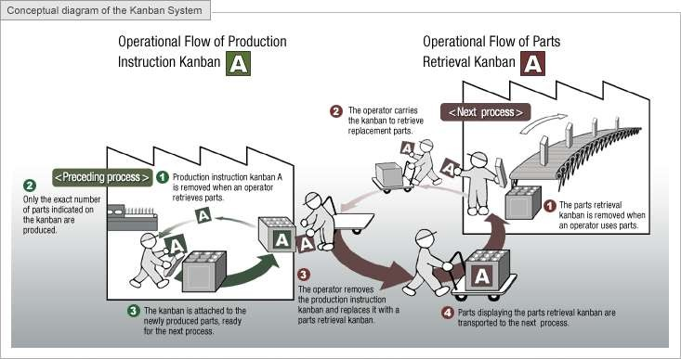
Kanban System
http://www.toyota-global.com/company/vision_philosophy/toyota_production_system/just-in-time.html

Slide 51
How Kanban helps achieve “Just- in-Time”
For example, to efficiently produce a large number of automobiles, which can consist of around 30,000 parts, it is necessary to create a detailed production plan that includes parts procurement. Supplying "what is
needed, when it is needed, and in the amount needed" according to this production plan can eliminate waste, inconsistencies, and unreasonable requirements, resulting in improved productivity.
http://www.toyota-global.com/company/vision_philosophy/toyota_production_system/just-in-time.html

Slide 52
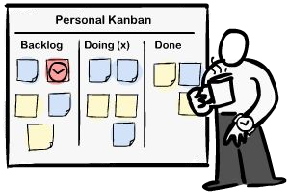
Kanban - 3 basic principles
Kanban Board
Start with what you do now
Kanban does not prescribe a specific set of roles or process steps
Agree to pursue incremental, evolutionary change
continuous small changes that stick vs. sweeping changes that fail due to resistance and fear in the organization
Respect the current process, roles, responsibilities & titles
gain support, reduce fear/resistance to change and experience the benefits as a team
www.torak.com

Slide 53
Kanban - 5 Core Properties
1. Visualize the workflow
Kanban literally means "signboard" or "billboard"
Limit Work In Process (WIP)
use a pull system - establish and respect your ideal capacity
Kanban Board
3. Manage Flow
monitor, measure and report the flow of work through each state
4. Make Process Policies Explicit
describe the process accurately in order to improve it
Improve Collaboratively
using models & the scientific method (empirical) to implement continuous, incremental and evolutionary changes
www.torak.com

Slide 54
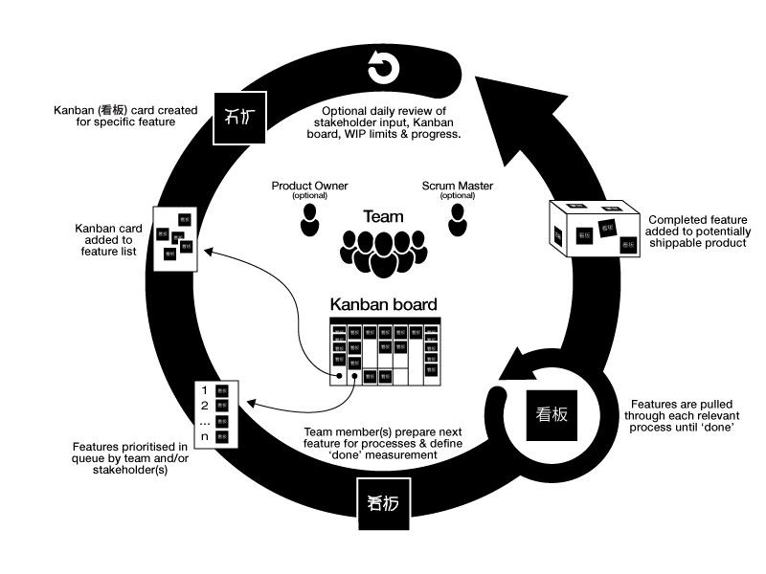
Kanban
source: http://finance.groups.yahoo.com/group/kanbandev/
www.torak.com

Slide 55
Kanban: Start 1
to do in process done
Start with a simple task board with 3 columns: to do, in process and done.
a
Each card represent a work item in the current scope. Names can be associated with the cards.
b
c
The key is to setup an easy way to visualize the work, and create an area for social interactions.
www.torak.com

Slide 56
Kanban: Start 2
to do in process done
Start with a simple task board with 3 columns: to do, in process and done.
a
Each card represent a work item in the current scope. Names can be associated with the cards.
b
c
The key is to setup an easy way to visualize the work, and create an area for social interactions.
to do in process done
A problem with such a simplistic board, is the lack of rules and the concept of time-boxing.
b
a
a
b
a
a
A typical problem is accumulating too much work in progress (WIP).
b
a
c
Kanban is more than just adding work items on a board, it's also applying a PULL process.
c
c
www.torak.com

Slide 57


Kanban: Start 3
to do in process done
Start with a simple task board with 3 columns: to do, in process and done.
a
Each card represent a work item in the current scope. Names can be associated with the cards.
b
c
The key is to setup an easy way to visualize the work, and create an area for social interactions.
to do in process done
A problem with such a simplistic board, is the lack of rules and the concept of time-boxing.
b
a
a
b
a
a
A typical problem is accumulating too much work in progress (WIP).
b
a
c
Kanban is more than just adding work items on a board, it's also applying a PULL process.
c
c
to do
ready
in process
done
To truly embrace Kanban, we must regulate the volume of cards on the board. This can easily be accomplished by identifying clear thresholds associated to better defined stages of work (columns).
a
a
b
c
c
Another improvement is to set a multi-tasking limit per user (2) and using late binding of tasks to owners. Note that not all team members must have 2 tasks with their names, this is a maximum of 2.
2
5
www.torak.com

Slide 58







Kanban: Mechanics
to do
ready
in process
done
a
a
b
c
c
to do
ready
in process
done
2 5
1. Team member A completes a card and moves it to the "done" column.
a
a
b
c
c
to do
ready
in process
done
2 5
2. Team member A pulls a new card from the "ready" column and starts working on it by placing it in the "in process" column.
a
a
a
b
c
c
2 5
3. The team responds to the pull event and selects the next priority card by moving it to the "ready" column.
www.torak.com

Slide 59




Scrumban: Flow
to do
ready
in process
done
to do ready specify execute done
b
a
b
a
b
b
c
c
c
c
2
5
2
2
3
Now that we have established our team capacity and we have a pull system, we can streamline the ideal flow.
www.torak.com

Slide 60




Kanban: Flow
to do
ready
in process
done
to do ready specify execute done
b
a
b
a
b
b
c
c
c
c
2
5
2
2
3
Now that we have established our team capacity and we have a pull system, we can streamline the ideal flow.
backlog | ready | specify | complete | execute | done
8 | 2 | a | b c 3 | a b c 3
www.torak.com

Slide 61





Why Kanban in Software Engineering?
Don’t build features that nobody needs right now
Don’t write more specs than you can code
Don’t write more code than you can test
Don’t test more code than you can deploy
https://leanandkanban.files.wordpress.com/2009/04/kanban-for-software-engineering-apr-242.pdf

Slide 62
Lean Startup Principles
The Lean Startup method teaches you how to drive a startup-how to steer, when to turn, and when to persevere-and grow a business with maximum acceleration.
Entrepreneurs are everywhere
Entrepreneurship is management
Validated Learning
Innovation Accounting
Build-Measure-Learn

Slide 63
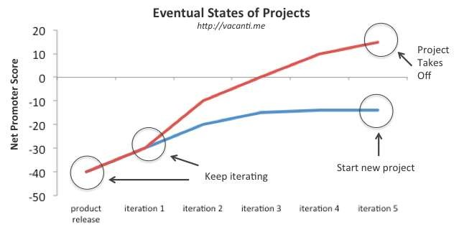
does iterating help?
http://viniciusvacanti.com/2011/12/12/when-do-you-throw-in-the-towel-on-your-struggling-project/

Slide 64
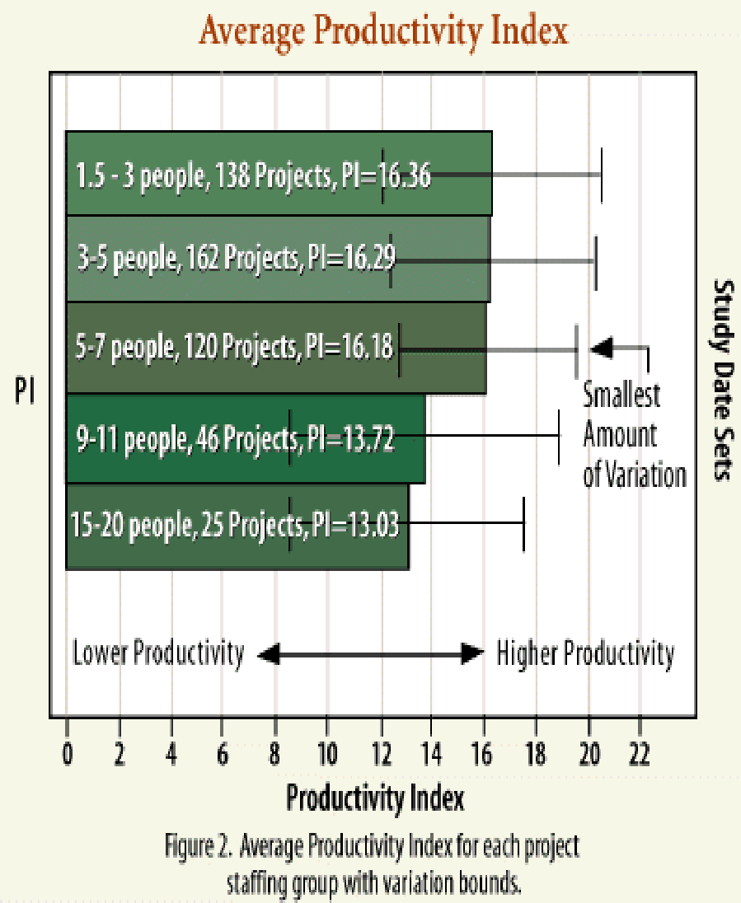
are small teams more productive?
http://drewcrawfordapps.com/2.0/the-agility-of-small-teams/

Slide 65
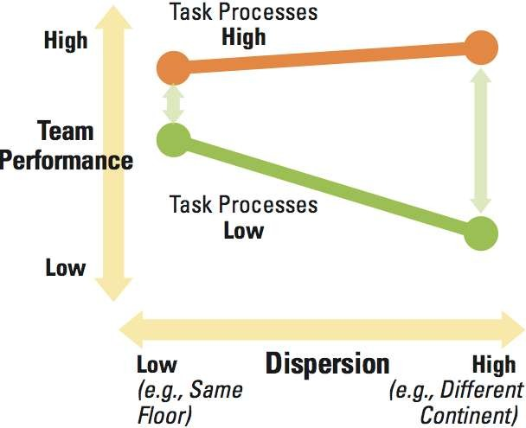
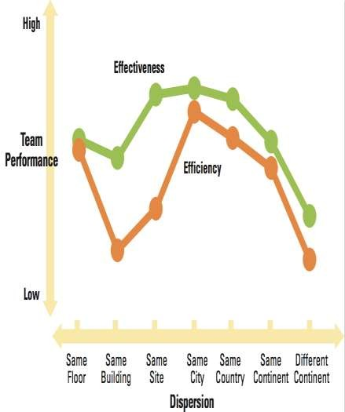
does colocation impact team performance?
http://sloanreview.mit.edu/the-magazine/2009-summer/50412/how-to-manage-virtual-teams/

Slide 66
Highlights from each ...
Scrum
ceremonies (daily scrum, review and retrospective)
time-boxed work using sprints
burn-down charts
XP - eXtreme Programming
best practices
coding (standards, collective code ownership, simple design, metaphor)
continuous integration
test driven development (unit tests, automated testing, acceptance testing)
When a Bug is found tests are created before the bug is addressed (a bug is not an error in logic, it is a test you forgot to write)
Kanban for development
visual board
pull system
JIT backlog/work
continuous flow
www.torak.com

Slide 67
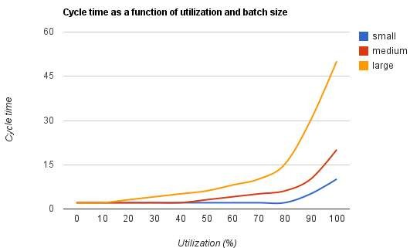
is small batch size faster?
http://www.andrejkoelewijn.com/wp/2011/06/30/is-team-productivity-a-responsibility-of-the-product-owner/

Slide 68
Recap
Agile ≠ Faster, but Sooner
Agile ≠ No planning, but Adaptive Planning
Agile ≠ More work, but ‘Done’
Agile ≠ No documentation, but Just Enough
Lean ≠ Cut the corners, but Reduce Waste
Agile or Lean don’t just change the development process, but enable a radical change in organizational culture, leadership and management practices that is more in line with business needs and social values and norms of today

Slide 69
References
http://butunclebob.com/ArticleS.TimOttinger.MoreWork
http://butunclebob.com/ArticleS.TimOttinger.SoonerNotFaster
http://www.toyota-
global.com/company/vision_philosophy/toyota_production_system/jidoka.html
http://www.toyota- global.com/company/vision_philosophy/toyota_production_system/just-in- time.html
http://www.danube.com/docs/Intro_to_Agile.pdf
http://codebetter.com/darrellnorton/2005/02/02/lean-software-development- overview/

Slide 70
Resources
http://www.extremeprogramming.org/
http://xprogramming.com
http://finance.groups.yahoo.com/group/kanbandev/
Takeuchi, Hirotaka; Nonaka, Ikujiro. "The New New Product Development Game". Harvard Business Review.
DeGrace, Peter; Stahl, Leslie Hulet (1990-10-01). Wicked problems, righteous solutions. Prentice Hall.
Kanban: Successful Evolutionary Change for Your Technology Business by David J. Anderson
Agile Software Development with Scrum by Ken Schwaber and Mike Beedle
Mary Poppendieck, Tom Poppendieck (2003), "Lean Software Development: An Agile Toolkit"
www.torak.com

